Slide 1


DEFINING MOVIE SUCCESS
BY:
JUSTin DEVRIES
ADAM KATZ
ALLISON PALKA
ALEX TORRES

Slide 2
MOTIVATION
As movie lovers, we wanted to investigate key factors that contribute to a film’s success within the industry.
What factors are relevant to film success?
Profit
Genre
Production Company
Visual Effects
Notoriety
Nominations

Slide 3
QUESTIONS AND DATA
We were able to brainstorm a few questions to begin our analysis and the API documentation on OMDB and TMDB assisted us in creating additional inquiries
We do believe we found sufficient data to identify key factors that can attribute to a film’s success

Slide 4
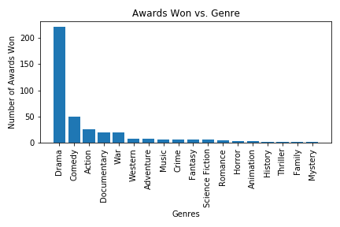
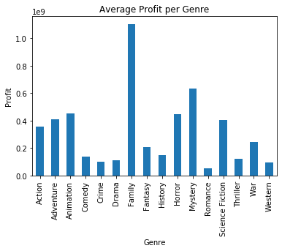
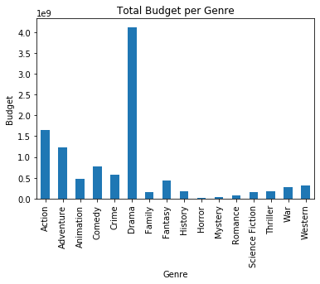
QUESTIONS AND DATA
Genre
Which genre has won the most awards?
Which genre has accrued the most overall profit on average?
Which genre has spent the most money on budget for film production?

Slide 5
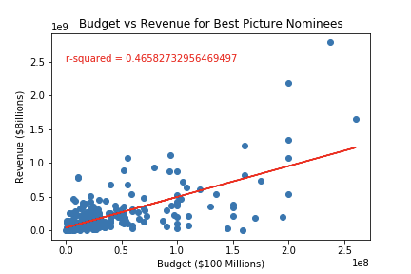
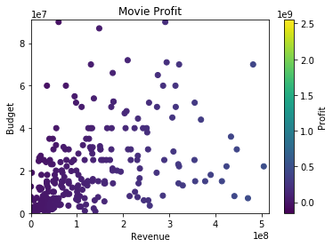
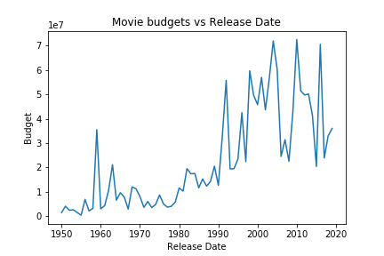
QUESTIONS AND DATA
Profit
Which films have produced the highest profit?
How have movie budgets changed over time?

Slide 6
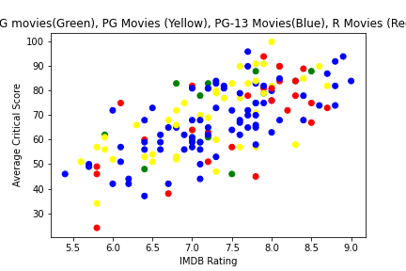
QUESTIONS AND DATA
Ratings and Critic Scores
Do movie ratings play a pivotal role in critic scores and ratings?

Slide 7
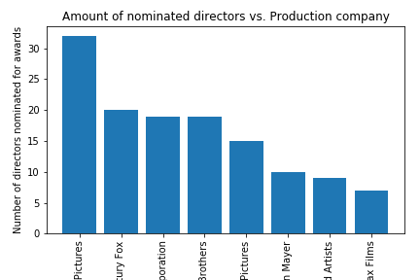
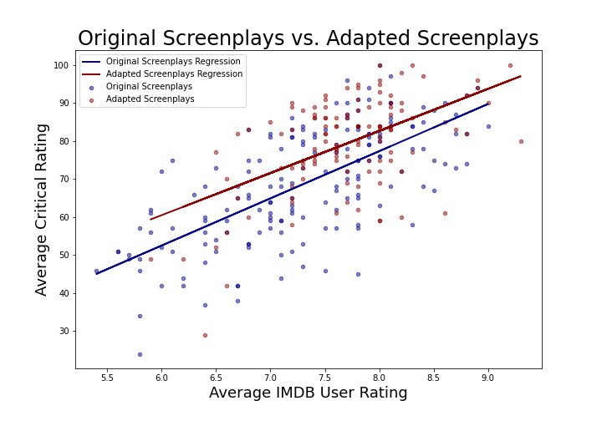
QUESTIONS AND DATA
NOTERIETY
SCREENPLAYS
Do Original Screenplays receive better ratings than adapted screenplays?
DIRECTORS
Which production company had the most directors nominated for awards?

Slide 8
CLEANUP & EXPLORATION
Our Process
Collectively deciding our subject platform for data analysis
Cleaning and sorting data for clear Data Frames
Determining Potential Outliers
Delegating questions and executing visualizations
Consistently communicating Github requests to ensure current datasets
Problems/Resolutions
GitHub Familiarity
Getting comfortable with Pull Requests
Managing conflicting Code
Initial time concerns with Data Cleaning
Best Practices for getting Data thru APIc calls
Task Delegation and Coordination

Slide 9
DATA HINDSIGHT
Questions we would have liked to pursue with more time include…
Which Production companies have generated the most profit?
Which decade saw the most revenue? Which director?
Playing more with actors/actresses through more searches
Playing with weighted nominations and aggregating data (costume design, best picture, etc.)
Adjusted our budget visualizations to consider inflation

Slide 10

DISCUSSION
Conclusions
Drama films tend to win the most awards
Box office successes tend to be family movies
Paramount Pictures has the most nominated film directors; Miramax has the least amount of nominations

